Slide 1
Global Terrorism
Baurjan Safi
General Assembly DSI-5
August 2017

Slide 2
Plan of Presentation
Data Set
EDA
Terror in Russia
Dagestan vs Chechnya
Imputing 1993

Slide 3
Data:
Over 170 thousand observations
Years from 1970 until 2016
Over 130 features
Decision:
Left only ones with geographic coordinates
Only 20 most consistent features
Added other data

Slide 4
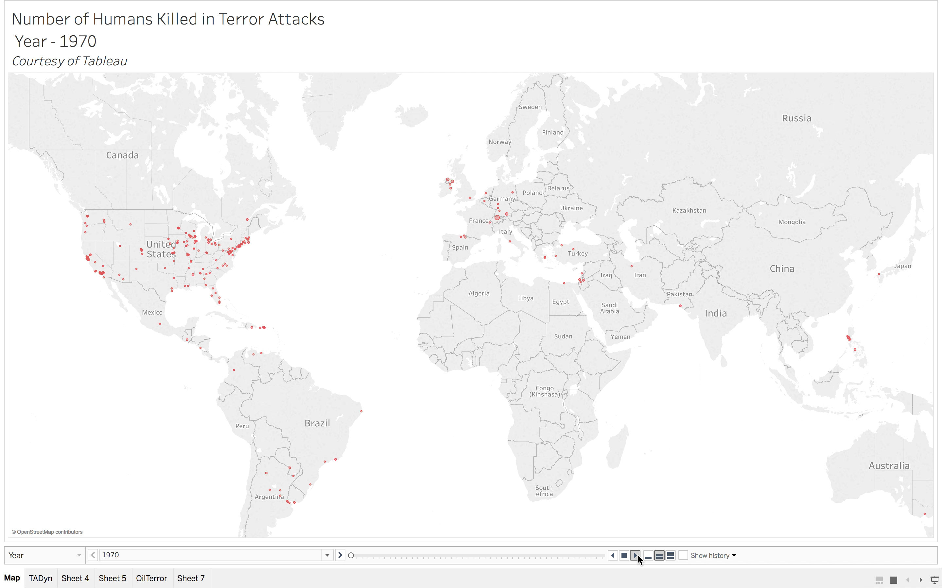

Slide 5
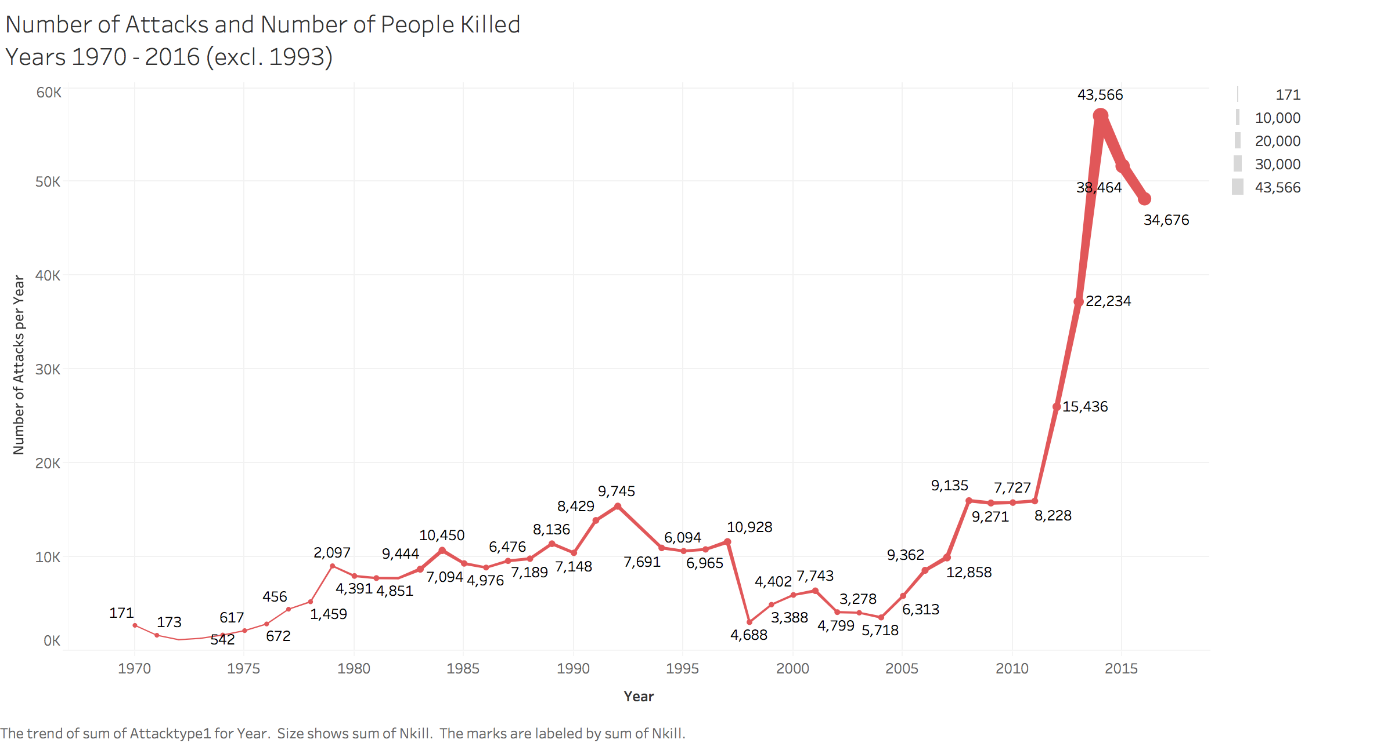
Terror Attacks Year to Year

Slide 6
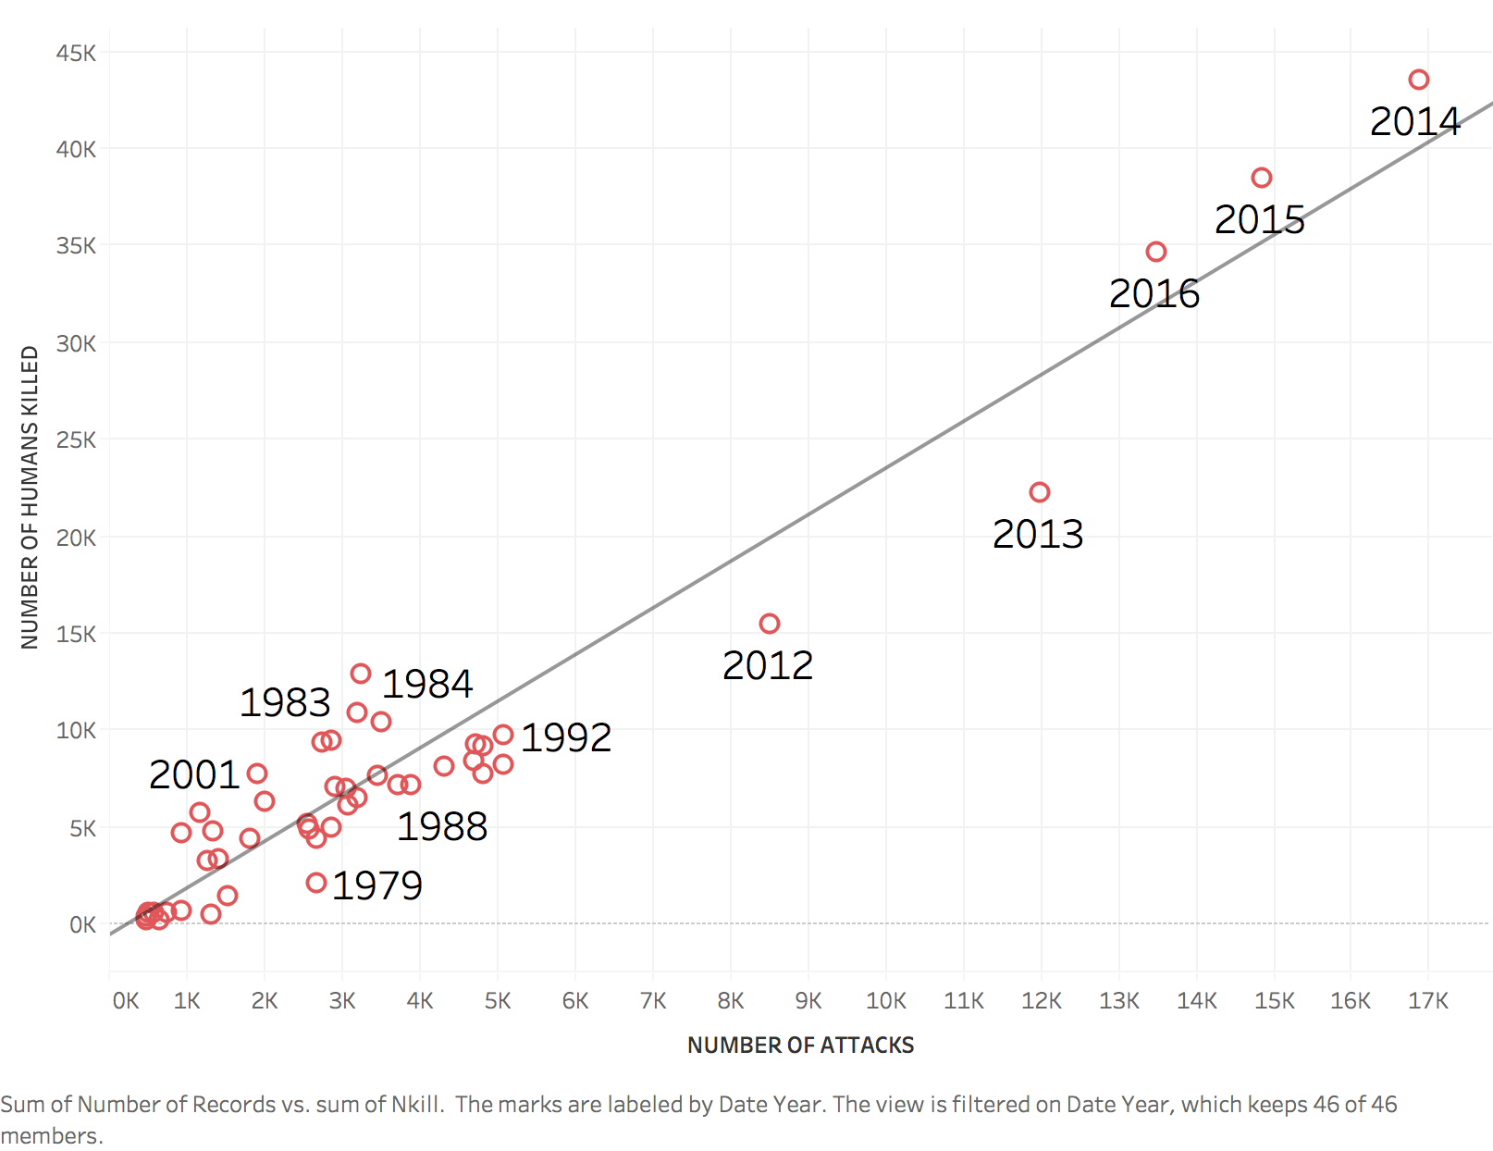
The Average Trend Stays Consistent – 2.4 humans fall victim of a terrorist attack

Slide 7
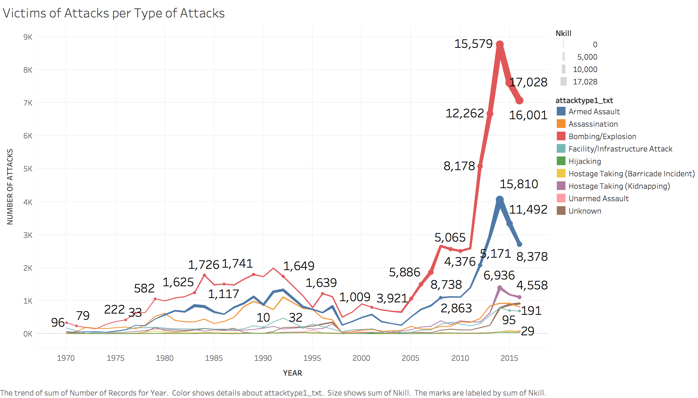
Types of Attacks

Slide 8
Homicides Globally
## | Country | Number of People Killed a Year * | ## | Country | Murders per 100,000 *
1 | Brazil | 55,574 | 1 | El Salvador | 108.6
2 | India | 41,623 | 2 | Honduras | 63.8
3 | Mexico | 20,762 | 3 | Venezuela | 57.2
4 | South Africa | 18,673 | 4 | US Virgin Islands | 52.6
5 | Nigeria | 17,843 | 5 | Jamaica | 43.2
6 | Venezuela | 17,778 | 6 | Lesotho | 38.0
7 | Russia | 16,232 | 7 | Belize | 34.4
8 | United States | 15,696 | 8 | South Africa | 34.3
9 | Pakistan | 13,846 | 9 | Saint Kitts and Nevis | 33.6
10 | Colombia | 12,782 | 10 | Guatemala | 31.2
* - https://en.wikipedia.org/wiki/List_of_countries_by_intentional_homicide_rate

Slide 9
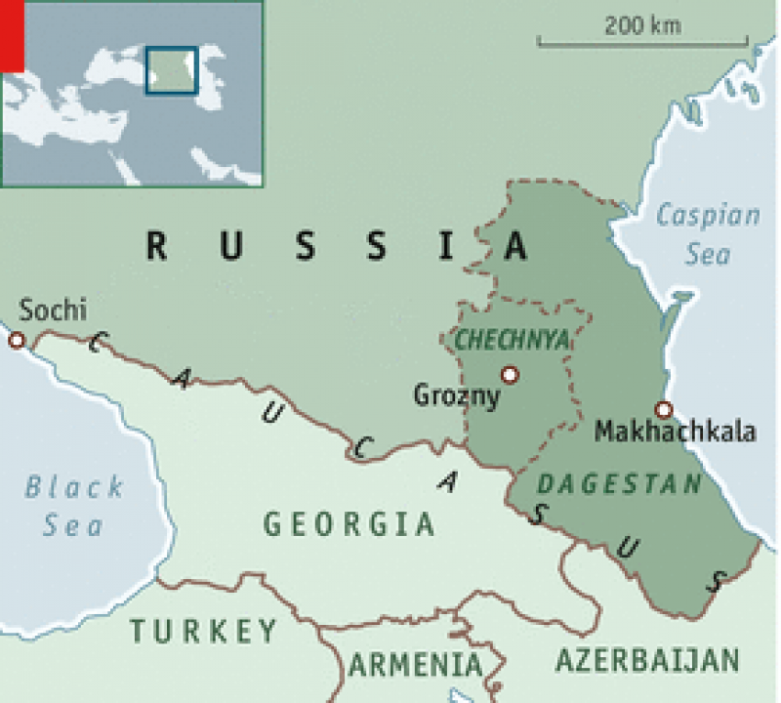
Neighbor: Fortune or Fate

Slide 10
Total Bomb Attacks in Russia

Slide 11
Posteriors for Dagestan and Chechnya

Slide 12
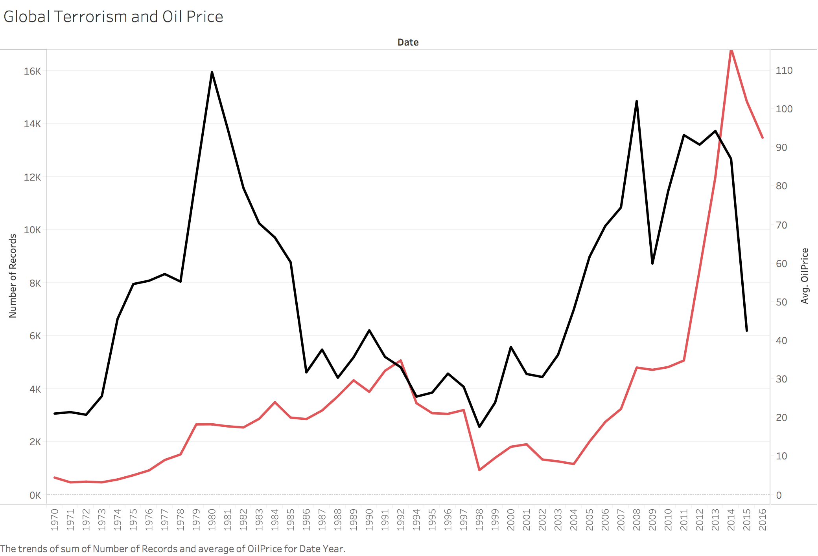
Does oil have anything to do with it?

Slide 13
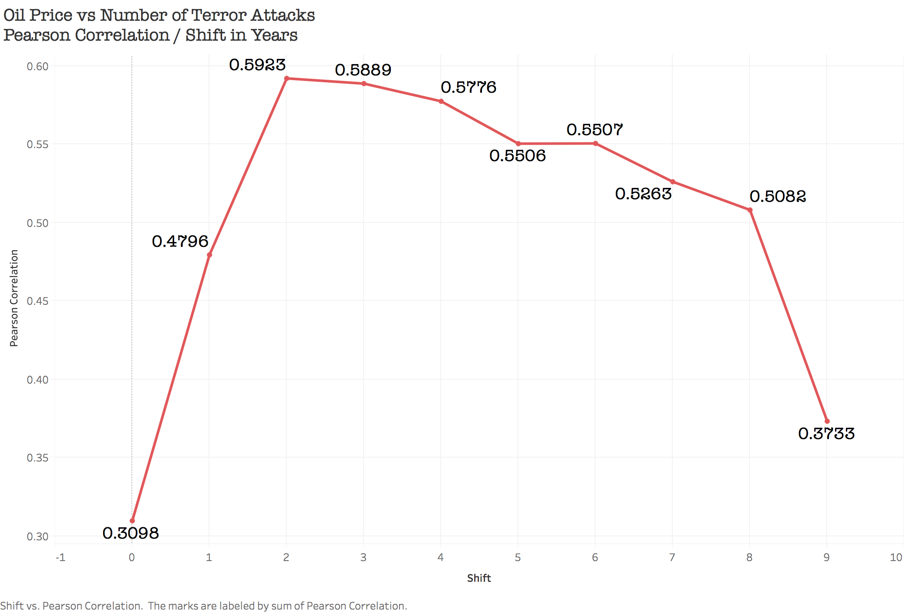

Slide 14
Imputing 1993

Slide 15
Rolling Mean to Impute 1993

Slide 16
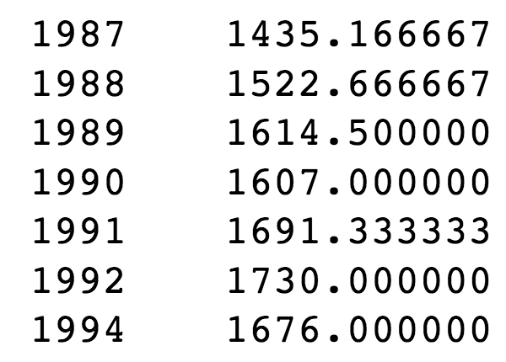
The Process is Not Purely Stochastic
Thus imputing 1993 will be simpler:
Number of bomb attacks is suggested as arithmetic average of the moving mean for 6 previous periods.
1703 bombing attacks

Slide 17
Conclusions:
Analysis has shown that terrorist activity in Russian republics of Dagestan and Chechnya are difficult to differ statistically. That speaks of a general nature of terrorism in both autonomous republics
Imputing 1993, has proved that the terrorism is not purely stochastic
The observed correlation between price of oil and terrorist activity is an important factor to remember that any illegal activity, especially one that involves buying weapon needs resources. Be that oil, drugs, gold, diamonds or human lives.

Slide 18
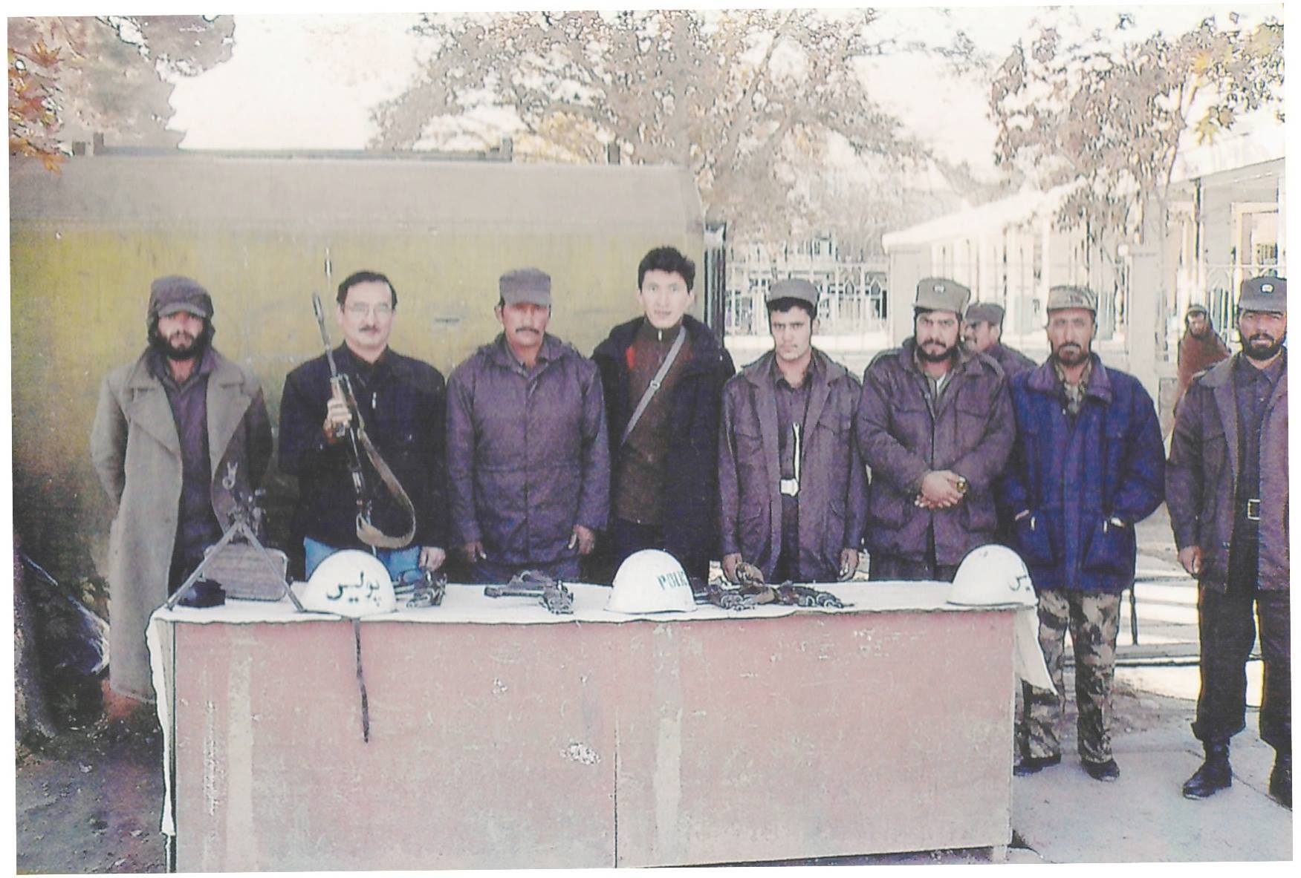
Questions and Discussion

